Slide 1

“Review-II of Major Project”
for E-4 (2016)
Submitted as part of Major Project
Authenticated and Secured Data Exchange by Digital Ledger
V. Jaya Pushpa Sri (S160492)
D. Divya (S160842)
A. Sruthi Chowdary (S160933)
K. S. Mounika (S160055)
Under the Supervision of:
Ms. Roopa Musidi,
Assistant Professor,
Department of Computer Science and Engineering
Email: roopamusidi@rguktsklm.ac.in

Slide 2
Authenticated and Secured Data Exchange by Digital Ledger

Slide 3
Contents
Abstract
Literature Survey
Problem Statement
Existing Systems and their disadvantages
Proposed System and its advantages
Technology used
Implementation
Results
Conclusion

Slide 4
Abstract
Communication is very important to maintain effective coordination and collaboration by exchanging data. While exchanging the data, Data Control, End-to-End Encryption, Cross-Communication, Device Compatibility, Compliance Capabilities, Advanced Administrative Controls, Open Communication, Transparency with Users, and A Zero Trust Practice are considered for secure and effective communication. Existing data-sharing platforms depend on trusted third parties (TTP). Due to the involvement of TTP, such systems lack trust, transparency, security, and immutability. To overcome these issues, we propose a blockchain-based secure data sharing platform by leveraging the benefits of the interplanetary file system (IPFS). To acquire the file/data, an authenticated and authorized receiver has to use transactions and interact with the system in four phases, including the data transfer request, encrypted data transfer, key retrieval, and data decryption. Compared with related work, the system can perform the four phases autonomously. It utilizes the permissioned blockchain, i.e. Hyperledger Fabric, for access control and can defeat dishonest receivers. We use asymmetric algorithm (RSA), SHA-512 for hashing, End to End encryption and consensus algorithms (Proof of work, Proof of authority) to keep records of every transaction developed in Python.
Keywords: Block Chain , Interplanetary File System, Hyperledger Fabric, Proof of work , Proof of authority.

Slide 5
Literature survey
[1]https://cs.paperswithcode.com/paper/bbs-a-blockchain-big-data-sharing-system
[2] https://link.springer.com/chapter/10.1007/978-981-15-2777-7_52
[3] https://www.irjet.net/archives/V5/i12/IRJET-V5I12268.pdf

Slide 6
Existing System
Data sharing platforms depend on trusted third parties
Cloud
Third Party
Software
End User/
Device
End User/
Device

Slide 7
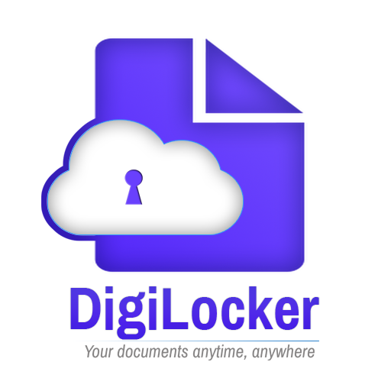


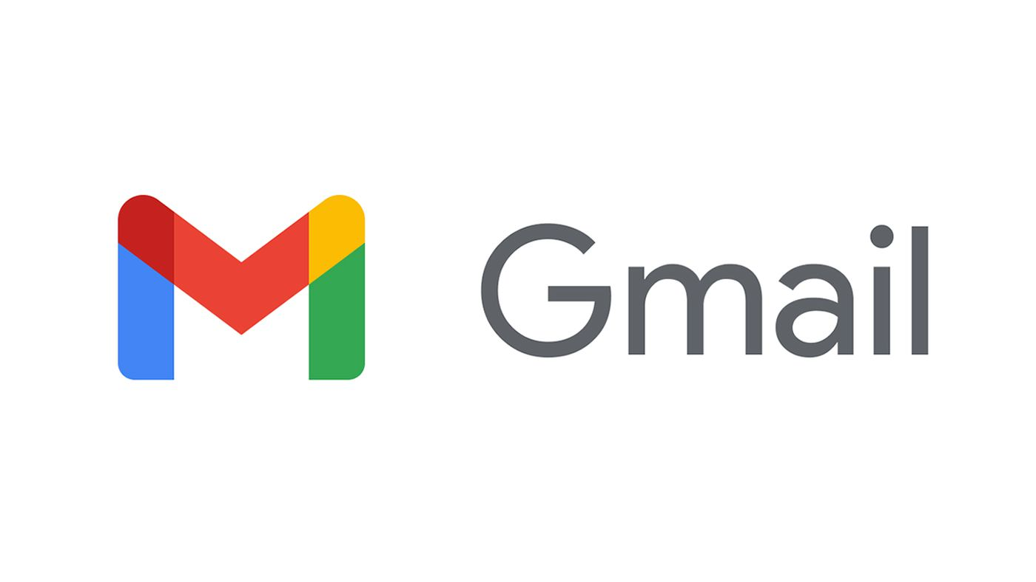
Existing Systems (Cont…)

Slide 8
Drawbacks of Existing System
No transparency
Lack of trust by TTP
Administrative controls
Possibility of data leak and data loss

Slide 9
Problem statement
Most of the data-sharing platforms depend on trusted third parties (TTP). Due to the involvement of TTP, such systems lack trust, transparency, security, and immutability. To overcome these issues, this model is developed using Digital Ledger by leveraging the benefits of the interplanetary file system (IPFS) in blockchain.

Slide 10
Proposed System
Metadata / Blocks Data / Ledgers
Cloud
Encrypted Data
System
Encrypted Data
Sender
Receiver
Data
Encryption
Decryption
Data
Public Key
Private Key

Slide 11
Advantages
Data security by End to end encryption
Transparency with users
Data control
Zero trust practice
Immutability of data

Slide 12
Technology Used
Block chain
Transparency with Users, and A Zero Trust Practice
To make a secured network and transparent ledger
Cryptography
End to end encryption for secure data exchange

Slide 13
Implementation
End to End Encryption : RSA Algorithm
Hashing Algorithm : SHA512
Blockchain implementation : Python
API : FastAPI
Asynchronous Server Gateway Interface : uvicorn

Slide 14
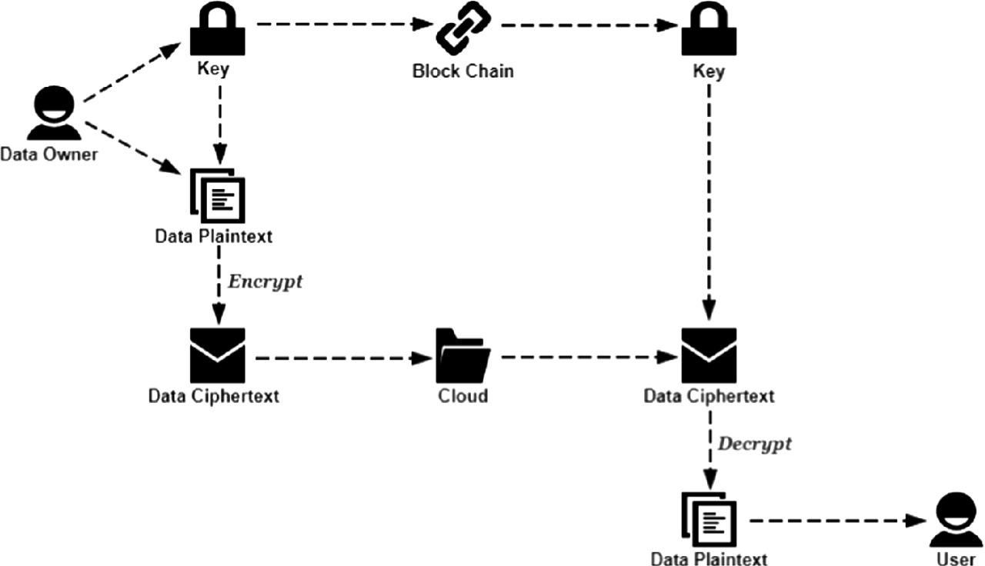
Model
User Account

Slide 15
Block Chain
Genesis Block
Transaction
Block 1
Transaction
Block 2
Transaction
Block N
Transaction
Index
Time Stamp
Data (Encrypted)
Proof
Previous Hash(0)
Sender ID
Receiver ID
Index
Time Stamp
Data (Encrypted)
Proof
Previous Hash
Sender ID
Receiver ID
Index
Time Stamp
Data (Encrypted)
Proof
Previous Hash
Sender ID
Receiver ID
Index
Time Stamp
Data (Encrypted)
Proof
Previous Hash
Sender ID
Receiver ID
.........

Slide 16
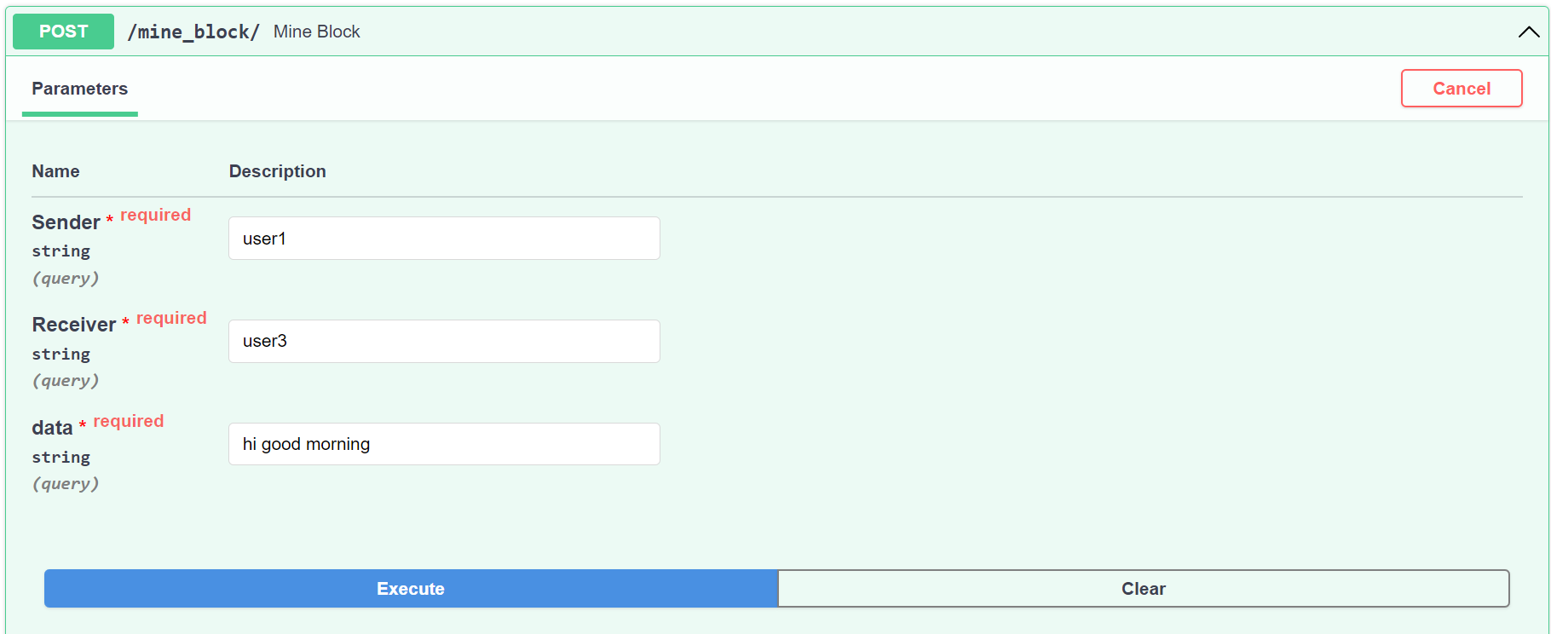
Results

Slide 17
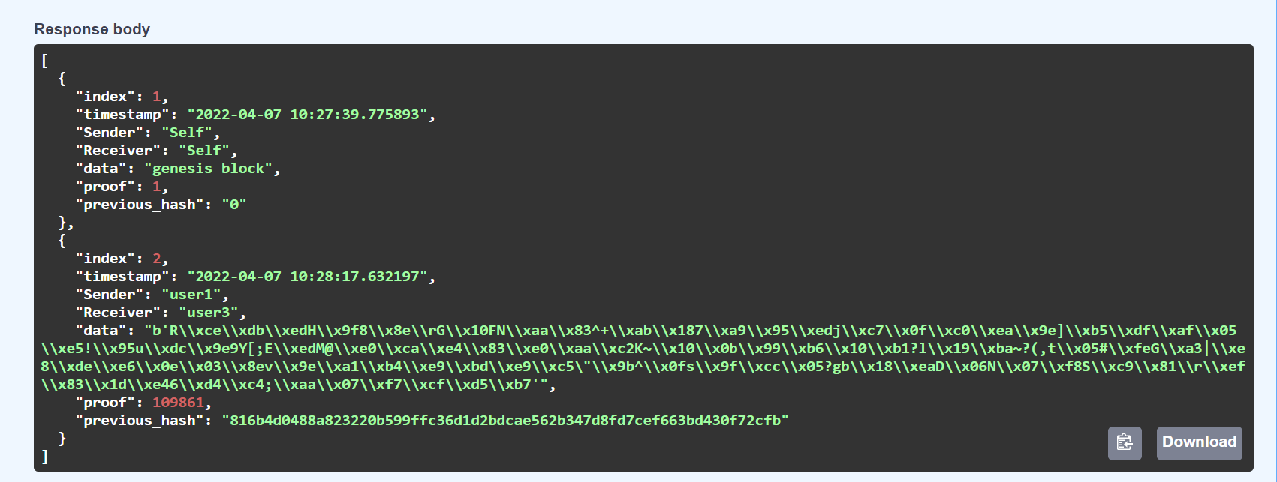
Results (Cont…)

Slide 18
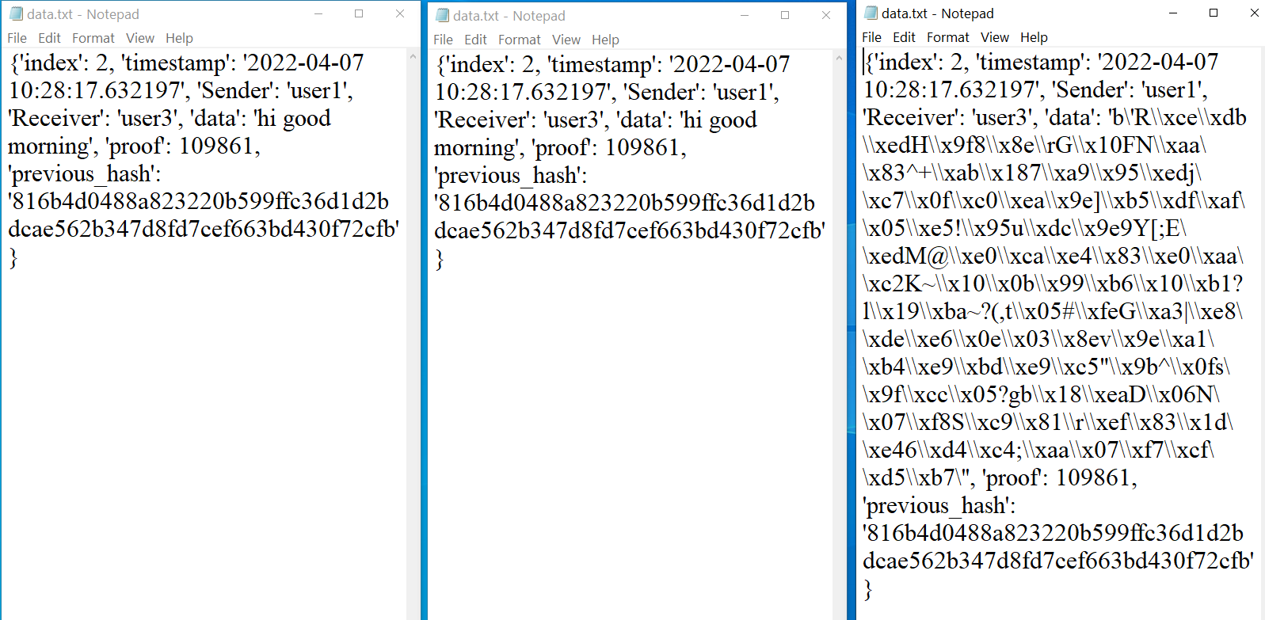
User1 User3 User2
.

Slide 19
Conclusion
By developing this model, we can ensure the following :
Secured data transfer
Transparent system for users
Proof of transfers by ledgers

Slide 20
THANK YOU

